Slide 1
UX EVALUATION TECHNIQUES
PRACHI V. RANE
MTECH 2017430012

Slide 2
EVALUATION
The meaning of evaluation is judge.
The judgement should be is such a way that the parameters are taken into the consideration while giving the judgement.
Example: If any model is designed the evaluation consists of pros and cons about the model so there is a chance of betterment of model in future.

Slide 3
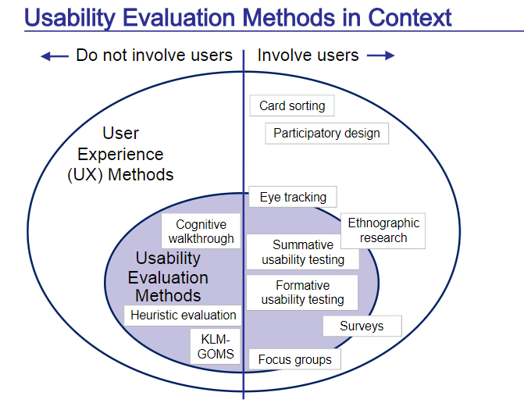

Slide 4
Formative vs Summative Evaluation
Formative evaluation helps you form the design and
Summative evaluation helps you sum up the design.
Example : When a mobile device used by Designer it is Formative, whereas used by layman it is Summative

Slide 5
Formative vs Summative Evaluation
Formative evaluation is primarily diagnostic; it is about collecting qualitative data to identify and fix UX problems and their causes in the design.
Summative evaluation is about collecting quantitative data for assessing a level of quality due to a design, especially for assessing improvement in the user experience due to formative evaluation.

Slide 6
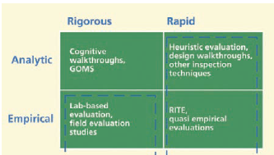
TYPES OF FORMATIVE AND SUMMATIVE EVALUATION METHOD
The following are the types of formative and summative evaluation techniques:
Empirical method vs. Analytic method
Rigorous method vs. Rapid method

Slide 7
TYPES OF FORMATIVE AND SUMMATIVE EVALUATION METHOD
Example: Working of the MOBILE DEVICE
Rigorous – Complete details of the system, maximize the effectiveness
Rapid- Results to be yield faster.
Empirical - How a design or design change pays off in terms of real observable usage.
Analytical - looking at inherent attributes of the design

Slide 8
Types of Evaluation Data
Objective Data vs. Subjective Data : Objective UX data are data observed directly by either the evaluator or the participant.
Subjective UX data represent opinions, judgments, and other subjective feedback usually from the user, concerning the user experience and satisfaction with the interaction design.
Quantitative Data vs. Qualitative Data: Quantitative data are numeric data, such as data obtained by user performance metrics or opinion ratings.
Qualitative data are non-numeric and descriptive data, usually describing a UX problem or issue observed or experienced during usage.

Slide 9
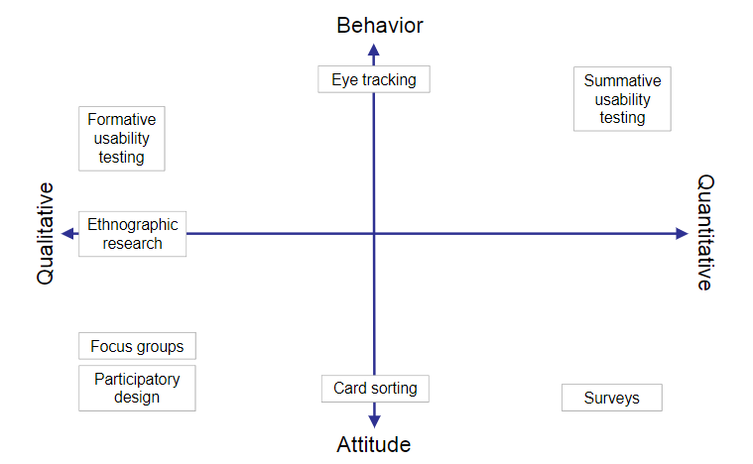

Slide 10
DATA COLLECTION TECHNIQUES

Slide 11
Critical Incident Identification
The Think- Aloud Technique
Questionnaires
Data Collection Techniques Especially for Evaluating Emotional Impact
Data Collection Techniques to Evaluate Phenomenological Aspects of Interaction

Slide 12
VARIATIONS IN FORMATIVE EVALUATION RESULTS

Slide 13
When the variation is due to using different evaluators, it is called the “evaluator effect”
Even if you use the same tasks, or the same evaluators, or the same participants, you will get different results.

Slide 14
REFERENCES

Slide 15
Rex Hartson and Pardha Pyla, The UX Book, MK publications.

Slide 16
THANK YOU!

